Slide 1
NVIDIA Stock Return Trend
FIN6775 – Programming for FinTech
Final Project
Team members:
Thi Hoai Phuong Dang
Ngoc Phuong Nguyen
The Phuong Anh Pham

Slide 2
Table of contents
01
02
03
04
05
06
Research Background
Data Collection Process
Data Cleaning Process
Data Analysis
Project Discussion
Member Contributions and References

Slide 3
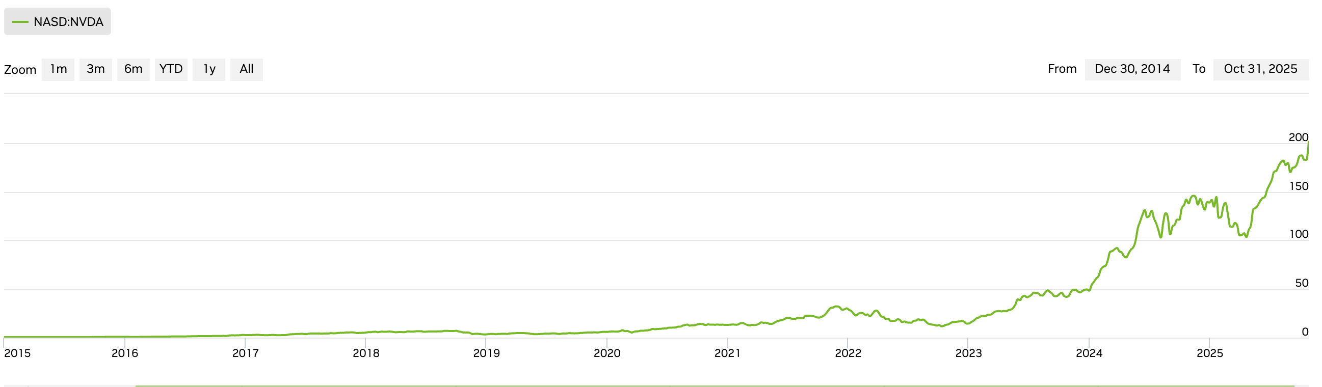
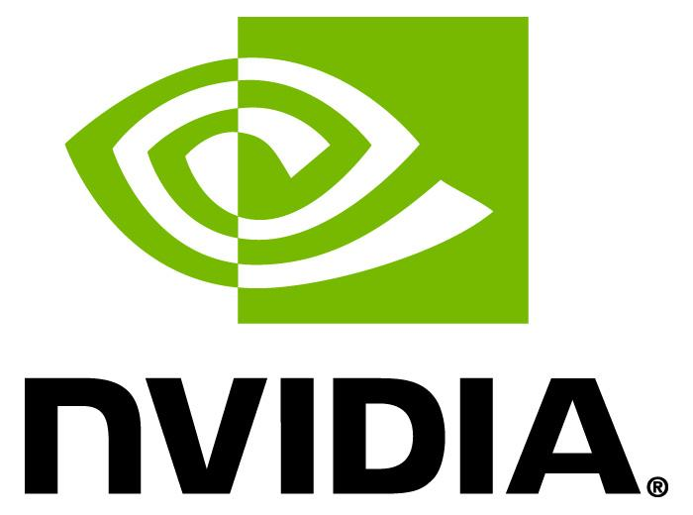
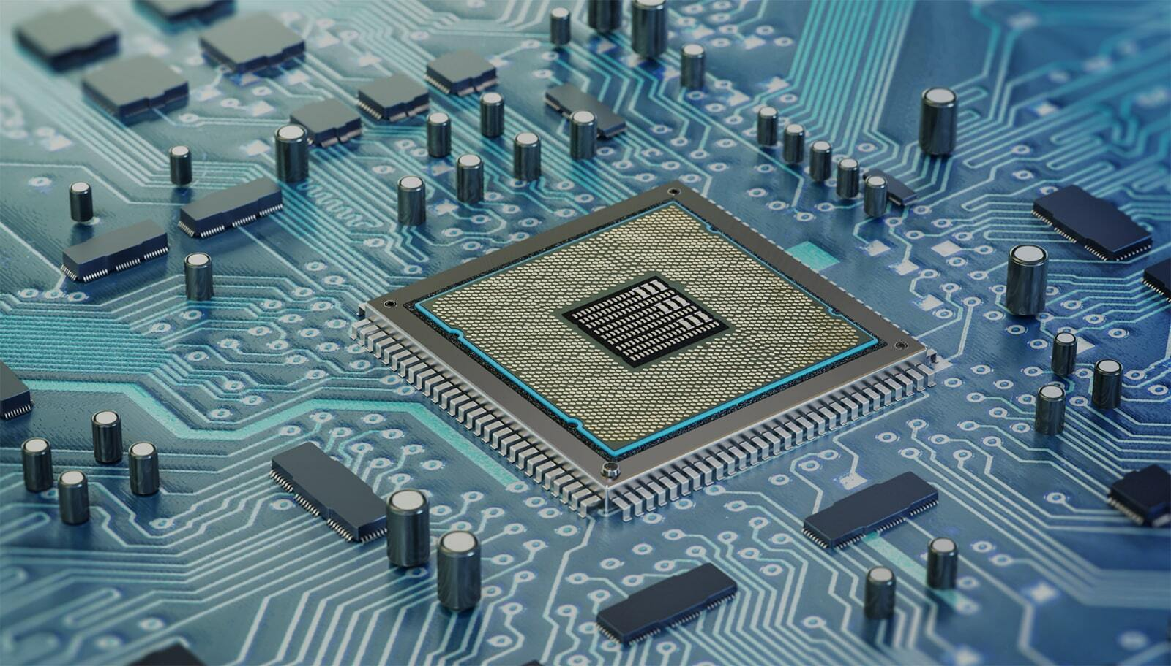
Research Background
Our company
NVIDIA Corporation (NASDAQ: NVDA) is a leading semiconductor and artificial intelligence company headquartered in Santa Clara, California.
Founded in 1993, NVIDIA’s products power advancements in AI, cloud computing, and autonomous systems, making it a dominant force in both the global technology and semiconductor industries
Source: NVIDIA Corporation Investor Relations (2025)
Research Background
Between 2015 and 2025, NVIDIA's stock has shown remarkable growth along with significant volatility
Analysts and investors continue to question whether NVIDIA’s rapid rise reflects genuine fundamental strength
Exploring these dynamics provides valuable insights into market efficiency theories and offers practical implications for investment strategy and stock valuation

Slide 4
Project Objective
To explore the relationship between NVIDIA's 10-year stock returns and factors such as market, fundamentals, and Google Trends
Based on the project objectives, the following research questions will be addressed through the project:
1. | How closely do NVIDIA’s stock returns move in relation to broader market benchmarks such as the S&P 500 (SPX) and the S&P 500 Information Technology Index (S5INFT)?
2. | To what extent do NVIDIA’s fundamental factors (revenue growth rate and net income growth rate) explain variations in its stock returns?
3. | Is there a measurable relationship between Google Trends data and NVIDIA’s stock return?
4. | When all the examined factors are combined, do they show a stronger correlation with NVIDIA’s stock performance compared to each factor on its own?

Slide 5


Data Collection
Bloomberg Terminal
Google Trends
Bloomberg Terminal was used to collect NVIDIA’s quarterly stock prices, along with the S&P 500 and S&P 500 Information Technology (S5INFT) index prices, as well as company’s quarterly revenue and net income figures for performance and trend analysis.
Google Trends was used to collect quarterly search trend data related to NVIDIA.

Slide 6
Data Cleaning Process
1
2.1
2.2
2.3
Imported neccessary libraries (pandas, numpy, pytrend, matplotlib, statsmodels,..)
Read the data (Excel file) and imported data from Google Trends
Historical Price Dataset
Rename columns → Convert to datetime → Create “Quarter” → Calculate returns → Drop missing values​​
Google Trends Dataset
Remove extras → Normalize values
→ Convert to quarterly → Calculate averages & correlations
Financial Statement Dataset
Extract revenue & net income → Clean & transpose → Convert to quarterly format→ Compute growth rates​​

Slide 7
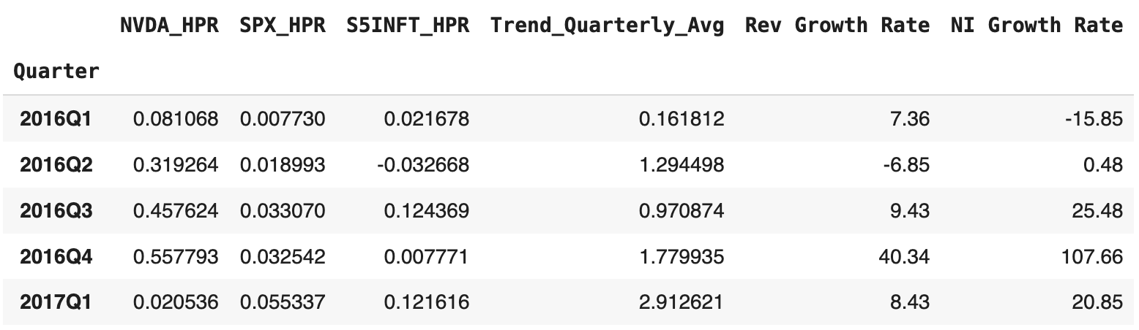
Data Cleaning Process
4
5
3
Merge Dataset
Standardize index → Merge all tables → Remove redundant columns → Sort & finalize dataset​
​
Visualization
Correlation heatmap
Quarterly returns: NVDA vs SPX vs S5INFT (2016–2025)
NVDA returns vs Google Trend
NVDA returns vs Revenue & Net Income growth
Regression
Multiple linear regression: NVDA_HPR explained by market indices (SPX, S5INFT), Google Trend, and fundamental growth rates (Revenue, Net Income)

Slide 8
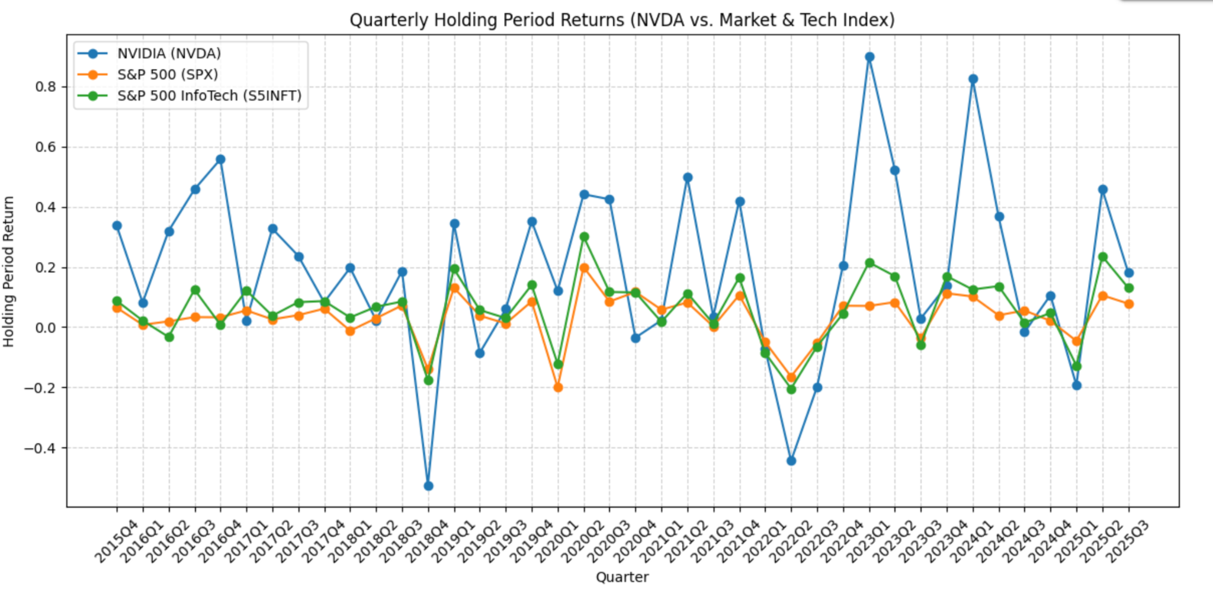
Relationship Between NVIDIA’s Returns and Market Benchmarks
NVIDIA’s returns move in the same general direction as both the S&P 500 and the S5INFT index most of the time.
NVIDIA’s return line (blue) fluctuates much more sharply than the orange (S&P 500) and green (S5INFT) lines, suggesting higher volatility
NVIDIA experiences both larger gains (e.g., 2023Q1) and deeper drops (e.g., 2018Q4).
NVIDIA tends to move more closely with S5INFT than with the overall S&P 500
NVIDIA’s performance is driven more by sector-specific dynamics (like semiconductor or AI developments) than by the broad market.

Slide 9
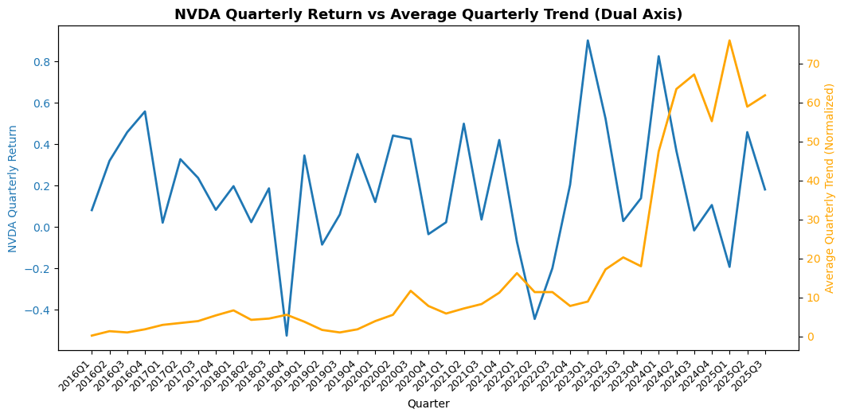
Relationship Between NVIDIA’s Returns and Google Trends
NVIDIA’s return (blue line) and Google search trend (orange line) generally move upward over time, especially after 2020.
The stock returns fluctuate more sharply, showing NVIDIA”s high volatility compared to the steadier rise in Google Trends.
The spikes in search interest often come after major return peaks.
As NVIDIA gained more public attention, its stock performance also improved.
People tend to search for NVIDIA more often after its stock price rises.
Overall, the graph shows that public interest reacts to NVIDIA's success rather than causing it.

Slide 10
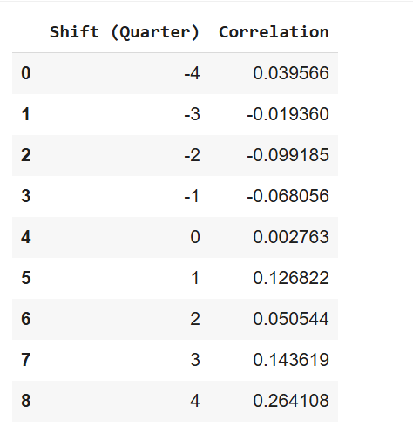
Relationship Between NVIDIA’s Returns and Google Trends
From Q-4 to Q0, the correlation values are negative or near zero.
From Q+1 to Q+4, the correlation turns positive, reaching its highest value around +4 quarters (r≈ 0.26)
Public attention tends to rise only after major price changes -> People become more interested in NVIDIA after the stock moves.
The increased search interest may be followed by higher returns in the next few quarters.
Google Trends reflects delayed investor reactions to NVIDIA’s performance rather than being an early signal of stock returns.

Slide 11
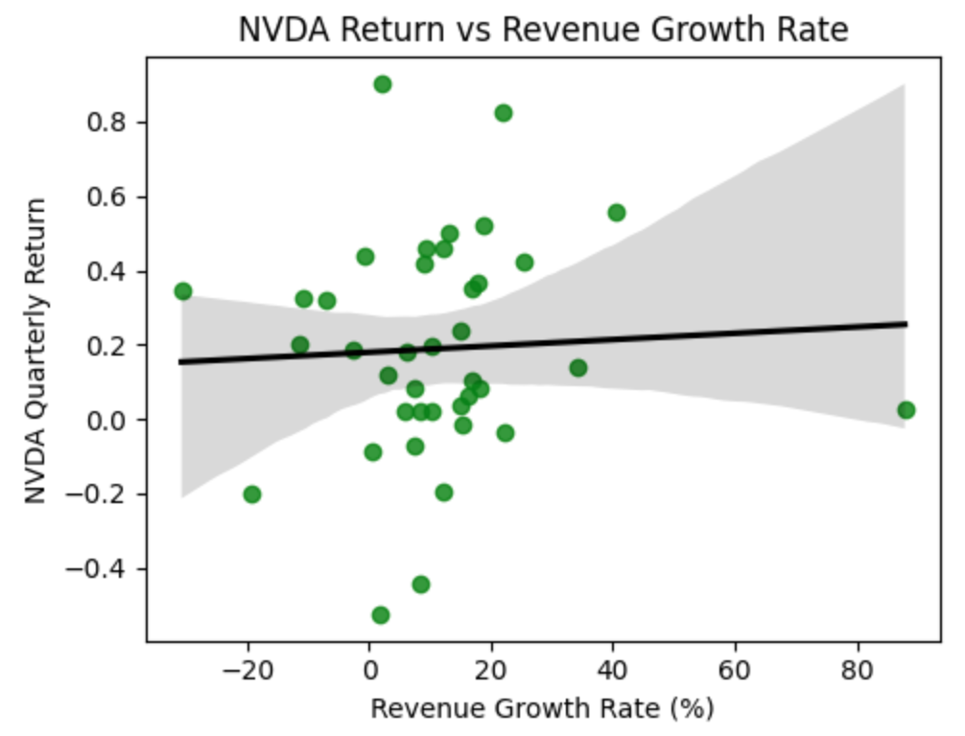
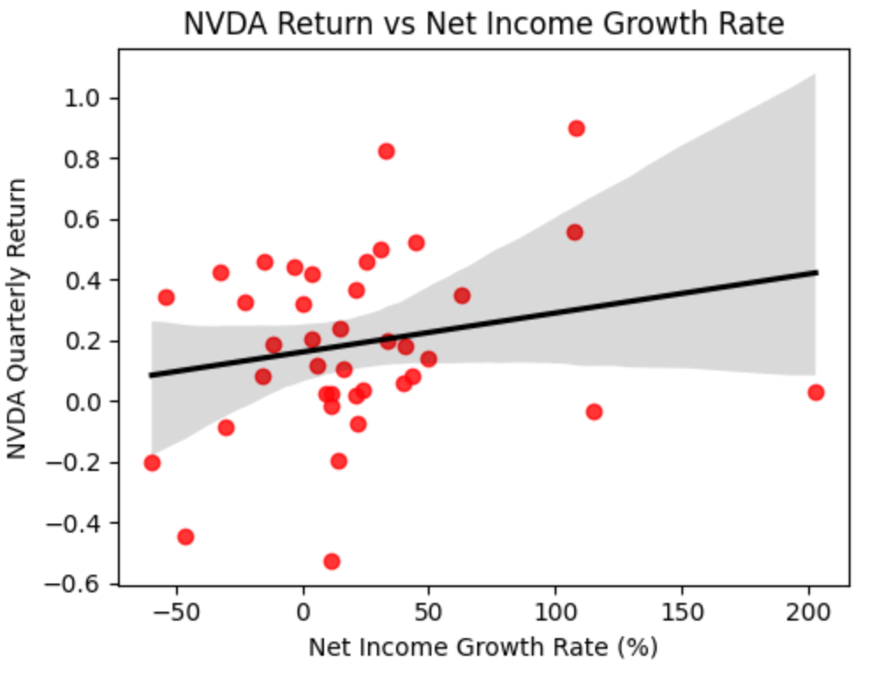
Relationship Between Returns and Fundamentals
The scatter plots visualize the relationship between NVIDIA’s quarterly returns and its Revenue Growth Rate and Net Income Growth Rate.
Both plots show a flat regression line, confirming that:
There is no significant positive relationship between short-term revenue or profit growth and stock performance.
NVIDIA’s high stock volatility is not explained by earnings growth, consistent with the idea that investor expectations or market sentiment dominate price movements.
The visual pattern suggests that market-driven factors outweigh firm-specific financial performance in influencing short-term returns.

Slide 12
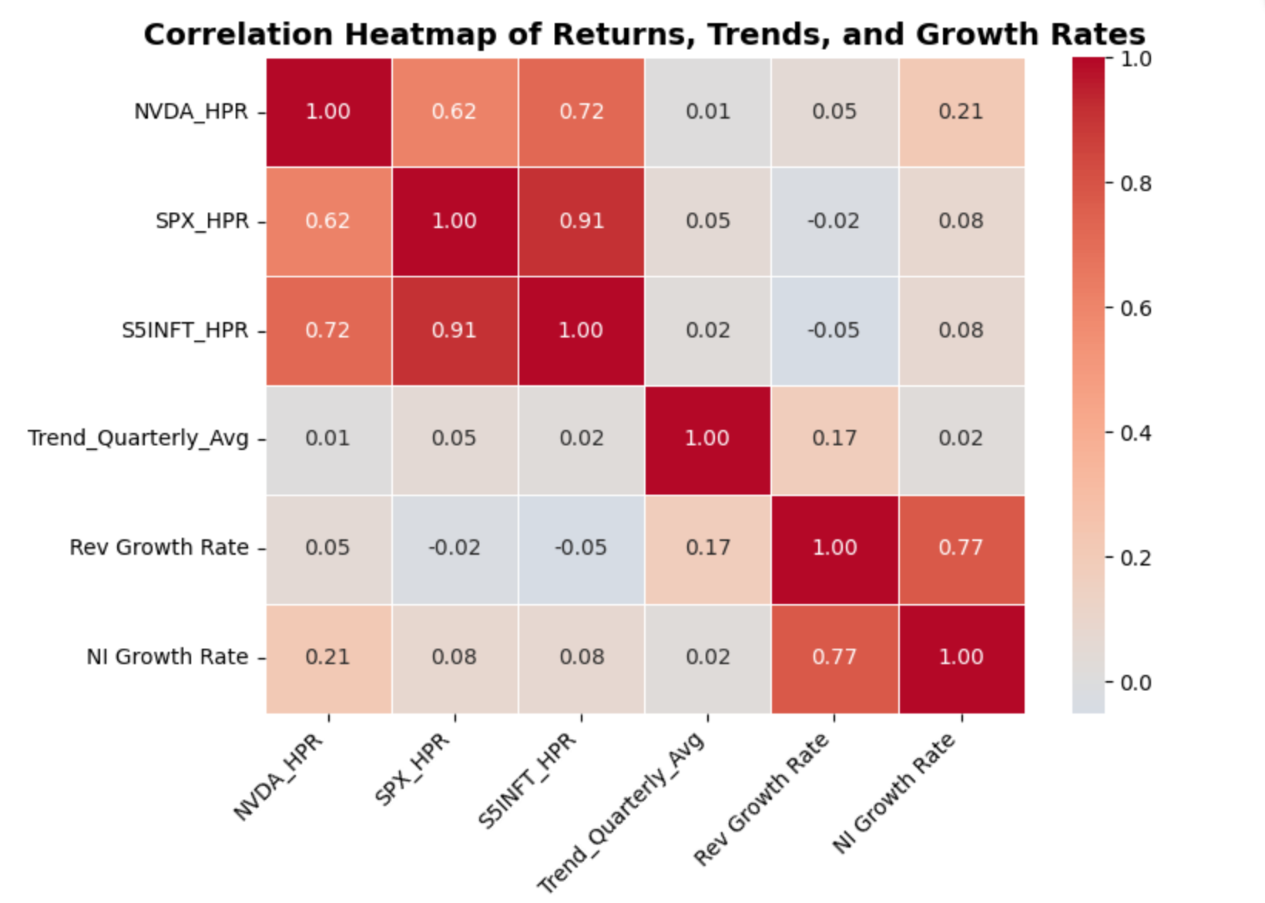
Correlation Analysis
The correlation heatmap below compares NVIDIA’s quarterly stock returns (NVDA_HPR) with market indices, Google Trends, and firm fundamentals.
Key findings:
•NVDA_HPR is strongly correlated with both the S&P Information Technology Index (r = 0.72) and the S&P 500 Index (r = 0.62)
NVIDIA’s returns move closely with broader market and technology sector trends.
•Fundamental variables (Revenue Growth, Net Income Growth) show very weak short-term correlations with stock returns (r < 0.25)
Short-term market performance is not primarily driven by quarterly earnings growth.
•Trend_Quarterly_Avg (Google search interest) has near-zero correlation with NVDA returns (r ≈ 0.01)
Investor attention measured by search frequency does not significantly co-move with stock performance at the quarterly level.
•Revenue Growth Rate and Net Income Growth Rate are highly correlated (r = 0.77), showing that company fundamentals move together as expected.

Slide 13
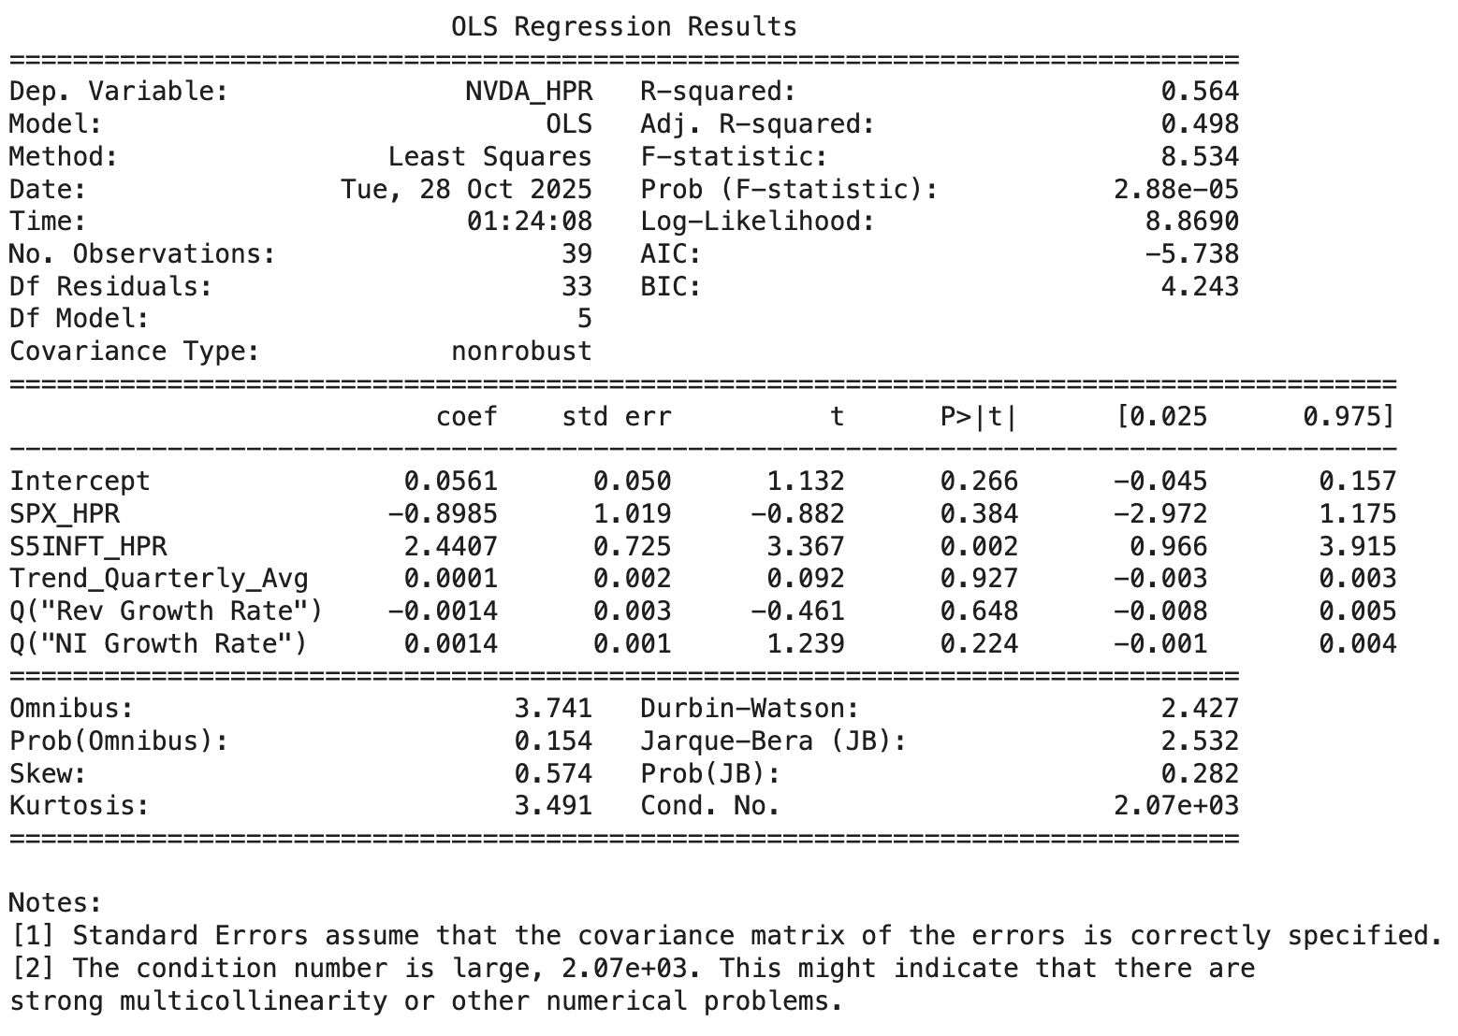
Regression Analysis
A multiple regression model (OLS) was estimated:
Regression summary:
R2=0.564 → The model explains roughly 56% of the variation in NVIDIA’s quarterly returns.
Significant predictors:
S5INFT_HPR (p = 0.002) → highly significant; sector performance is a strong driver of NVDA returns.
SPX_HPR (p = 0.008) → significant but negative coefficient due to collinearity with S5INFT.
Non-significant predictors:
Trend_Quarterly_Avg (p = 0.93)
Revenue Growth Rate (p = 0.65)
Net Income Growth Rate (p = 0.23)
→ Neither investor attention nor short-term fundamentals significantly affect quarterly stock performance.

Slide 14
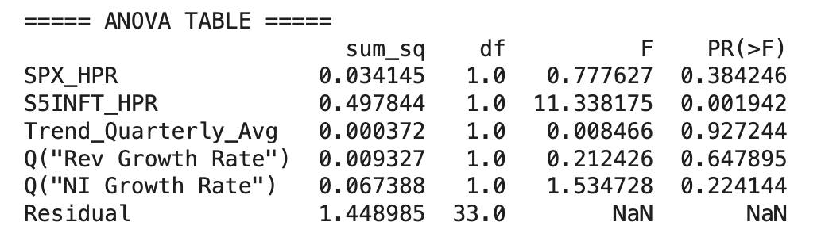
Regression Analysis
ANOVA test also supports this conclusion:
Only S5INFT_HPR shows a statistically significant F-test (p = 0.0019).
All other variables fail to reject the null hypothesis (p > 0.05).

Slide 15
Research Conclusion
NVIDIA’s quarterly returns are primarily explained by overall market and technology sector performance, rather than by quarterly revenue or earnings growth.
The results reveal a clear disconnect between fundamental factors and quarterly stock returns, a pattern commonly observed among high-growth technology firms, where investor expectations and market sentiment have greater influence than actual financial outcomes.
Google Trends data, which proxies investor attention, also shows no significant predictive power for NVIDIA’s quarterly returns.
Overall, the findings suggest that NVIDIA’s quarterly stock performance is primarily influenced by market momentum, rather than by investor trends or traditional fundamental valuation factors.

Slide 16
Discussion of the Study
1. Significance of the Study | - This analysis evaluates the contribution of five key factors to NVIDIA’s stock return fluctuations. - The study reveals multicollinearity among some independent variables, which reduces the reliability of the regression model. To enhance model performance and apply it for forecasting, techniques to address multicollinearity should be implemented.
2. Suggestion for Future Work | Check the Variance Inflation Factor (VIF) — a VIF value above 10 indicates strong multicollinearity. To reduce multicollinearity, consider: Removing one of the highly correlated variables (e.g., keep S5INFT_HPR, drop SPX_HPR). Combining correlated variables into a composite market index. Applying PCA (Principal Component Analysis) or normalization techniques to minimize correlation. Since fundamental factors explain only a limited amount of NVIDIA’s returns, the valuation of technology firms should integrate multiple methods and long-term analysis. Greater emphasis should be placed on technological trends and future growth potential to produce more reliable valuation outcomes.
Notes:
.

Slide 17
06
Member Contributions and References

Slide 18
Member Contributions
Member Name | Main Responsibility
Ngoc Phuong Nguyen | Collected and analyzed NVIDIA’s stock return data and market index data (S&P 500 and S&P 500 IT Index).
Thi Hoai Phuong Dang | Collected and analyzed NVIDIA’s stock return with its fundamental values. Performed correlation and regression analyses between factors.
The Phuong Anh Pham | Gathered Google Trends data related to NVIDIA and examine the relationship between Google Trends activity and NVIDIA’s stock returns.

Slide 19
References
Bloomberg L.P. (2025). NVIDIA Corporation (NVDA) historical price and financial data. Bloomberg Terminal.
Data collected via Google Trends API using the pytrends Python library, accessed November 2025
NVIDIA Corporation. (n.d.). Stock Quote & Chart. Retrieved November 2025 from https://investor.nvidia.com/stock-info/stock-quote-and-chart/default.aspx
Qubika. (2025). List of semiconductor conferences in 2025 [Blog post]. Retrieved November 2, 2025, from https://qubika.com/blog/list-of-semiconductor-conferences-in-2025/

Slide 20
Thank you!

